Slide 1
Pre-Arrival Presentation for Incoming Visiting Students
Notes:
Welcome to Yale Summer Session! This is the pre-arrival presentation for incoming visiting students. We are thrilled to have you attending a program with us this summer.
We know you’ll enjoy the academic program and the charming small city where you will study. If you are living on campus, we are very excited to introduce you to a Yale residential college and invite you to participate in our many activities and programs.
This webinar will review some of the basic information you need to know before coming to Yale this summer. Please follow along and don’t hesitate to email or call us if you have further questions. For your reference, Yale Summer Session is sometimes known as ‘YSS’.

Slide 2
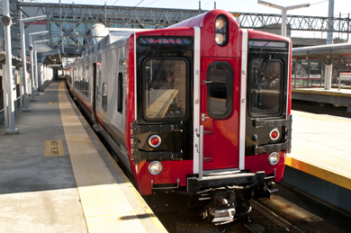
Getting to New Haven
Admitted Students on YSS Website
JFK, La Guardia, Newark, Bradley, and sometimes Tweed
Make arrangements to take a shuttle to campus from those airports
Amtrak or Metro North and bus services (via Greyhound, Megabus and Peter Pan) arrive at Union Station in New Haven
Notes:
Getting to New Haven. Visit the YSS website and click on the ‘admitted students’ tab. On that tab, there are subheadings with pre-arrival information. Click on “travel information” to access how to get to New Haven.
The most common airports students use are: JFK, La Guardia, Newark, Bradley, & sometimes Tweed.
The information to make arrangements to take a shuttle, either using Go! Airport Shuttle or Connecticut Limo from the airport to campus, is on our website. Train (via Amtrak or Metro North) and bus service (via Greyhound, Megabus and Peter Pan Bus) arrive in New Haven at Union Station.

Slide 3
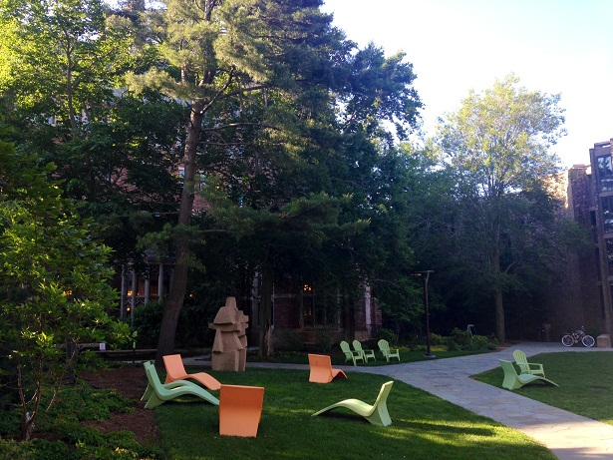
Required Forms
Submit your confirmation form in your student portal
Optional forms available for:
Course Change Request form
Housing and Meals add/drop Request form
Cancellation of Summer Registration
Notes:
Required Forms.
After you have received your offer of admission, you must confirm (or decline) the offer via the Confirmation form, found in your student portal. To accept your offer of admission, look for the Forms header on your status page. Click on the “Reply to Offer of Admission” link, and follow the prompts. Please understand that your spot in Yale Summer Session is not confirmed until you have filled out this form.
There are additional optional forms that we have available for you. The course change request form is used for students in YSS who wish to request a course change before the session begins. Requests usually take about a week to be reviewed.
This form is available until one week before the start of the session, after that all courses change requests must be done in person in the YSS office. Please note the first request is free, but a $60 charge will be added to your bill for each additional request.
If you would like to add or drop on-campus housing and meals, please fill out the Housing and Meals Add / Drop Form. Lastly, if you will not be joining us this summer, please fill out the cancellation of summer registration form.

Slide 4
NET ID & Password
Your Net ID and PIN will be sent to you within 2 weeks of your acceptance. If you have not received your Net Id and PIN emails and it has been more than 3 weeks since you have received your decision, please contact: summer.session@yale.edu.
Notes:
Your Net ID and PIN will be sent to you within 2 weeks of your acceptance. If you have not received your Net Id and PIN emails and it has been more than 3 weeks since you have received your decision, please contact: summer.session@yale.edu.

Slide 5
Upload a Photo for Your Photo ID
In order to upload your photo, you will need to have activated your NetID.
Please go to http://www.yale.edu/idphotoupload/ to upload your photo as soon as you receive your NET ID and password.
If done ahead of time, your ID card will be ready prior to your arrival at Yale.
Access to Yale facilities, shuttle bus, the gym, libraries, events and more
Residential students use their ID to access housing and meals
Notes:
Upload a photo for your photo ID. In order to upload your photo, you will need to have activated your NetID. After you receive your NetID and activate your account we strongly advise you to upload a photo. Please go to the ID center website at http://www.yale.edu/idphotoupload/ to upload your photo as soon as you receive your NET ID and password.
If done ahead of time, your ID card will be ready prior to your arrival at Yale.
Your ID gives you the access you need to Yale facilities, shuttle buses, the gym, libraries, events and lots of other things on campus. Residential students use their ID to access their housing and meals.

Slide 6
Do You Owe Money?
Bill due date: two weeks prior to arrival
Pay tuition and other fees before you register for classes
Activate your NetID, log in to your SIS (Student Information System) to look up your balance
Notes:
Do you owe money? The due date for your bill is two weeks prior to your arrival.
After you activate your NetID, log in to your SIS account to look up your balance.

Slide 7
Housing Check In
Check into housing upon arrival
Housing dates and details on the YSS website
International students: Office of International Students and Scholars
Notes:
Housing Check In. If you’re living on campus, you’ll need to check into housing when you arrive. We will send you information about housing check in via email about a week before your session starts. Specific dates and details about housing can be found on the “admitted students” tab on the website.
International students are REQUIRED to check in with the Office of International Students and Scholars upon arrival to Yale. This is for international students who received an immigration document (I-20) from YSS.
This is a mandatory process and is required to stay in legal status.

Slide 8
What to Pack
Clothing you can layer for variable weather in June and July
Informal or athletic wear
Sweater or light coat
Umbrella or rain coat
Business casual attire for events/activities
Notes:
What to Pack. The weather in June is hot, but less humid and July is usually hot and humid. This can vary from year to year though. Check the internet before you arrive to see what the weather will be like.
Some classrooms have air conditioning but the individual dorm rooms do not. Certain areas of the residential colleges have air-conditioning like the dining halls and some of the common areas.
In regards to clothing, we recommend, clothing you can layer, informal or sports clothes, a light sweater or light coat, an umbrella and/or raincoat, and business casual attire for special events and activities.

Slide 9
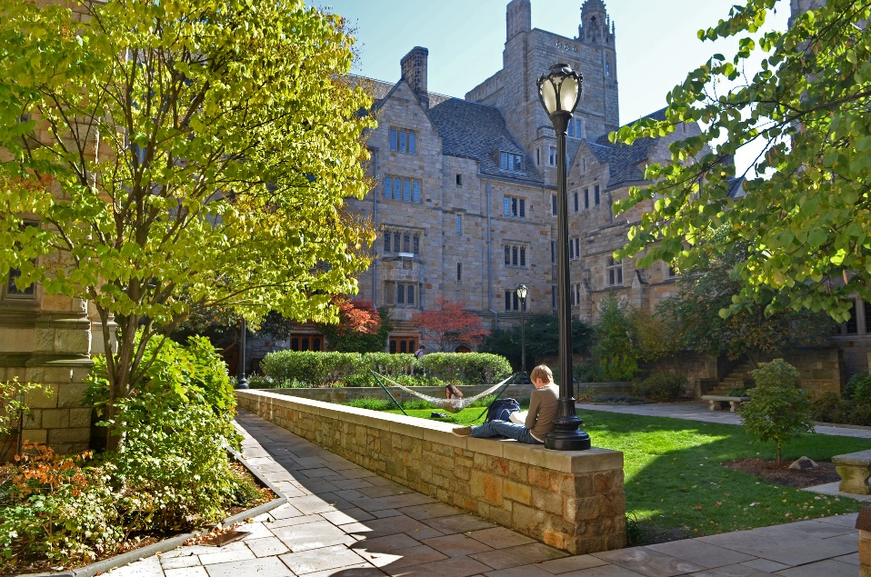
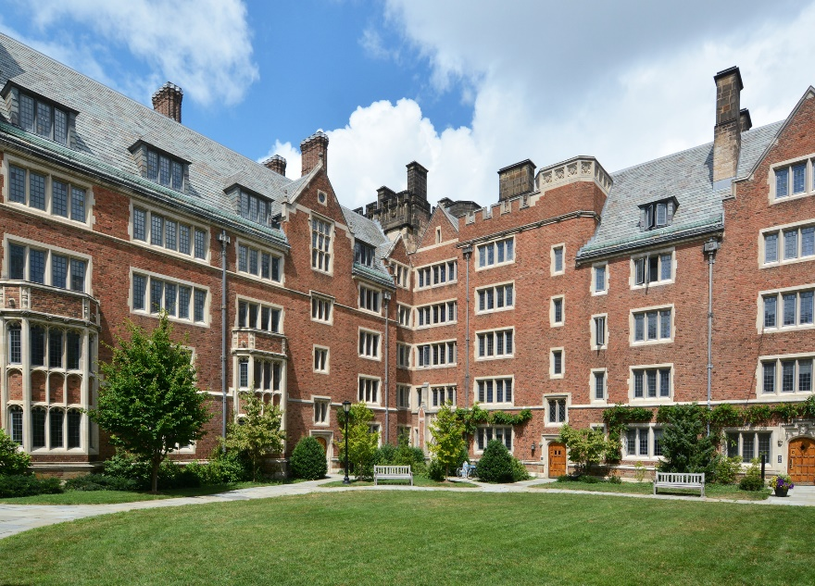
Living in the Residential Colleges
Residential Colleges
Residential Counselors
Activities
Residential Life tab
Meals & Dining
Notes:
Living in the Residential Colleges. The Yale residential colleges are where students live on campus during the summer if someone selects on campus housing. They are gated communities with a dining hall, library, and common rooms.
All students will be assigned a residential counselor. Residential counselors are current Yale students who will serve as a wonderful resource to help you adjust to life at Yale. They also coordinate a variety of cultural and fun activities.
Check out the “residential life” tab to learn more about the summer campus community and events planned for you!
Students living on campus will receive a full meal plan in a college dining hall. Hot and cold food options are served at every meal. Vegetarian and vegan dining options are also available. Yale Dining can accommodate a wide variety of special dietary needs.

Slide 10
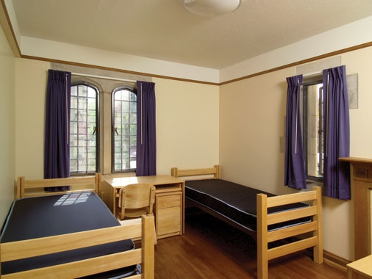
Your Dorm Room
Includes: twin bed, mattress, pillow, light blanket, dresser, chair and a desk
Bring: sheets (twin extra-long), towels, laptop
Available for purchase at the Yale Bookstore: fan, desk lamp, small household items
Notes:
Your Dorm Room. If you’re living on campus, your room includes a twin bed with a mattress, pillow, light blanket, a dresser, chair and desk.
Sheets and bath towels are not included, so bring those or buy them when you arrive. The sheet size for the bed is twin, extra-long. Additional items that you may need can be purchased at the Yale Bookstore.

Slide 11
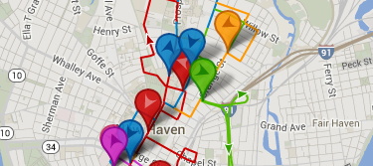
Getting Around Campus
View the Campus Map
Yale Shuttle
Download the “Mobile Access” App
Notes:
Getting Around Campus. New Haven is a small and walkable city! View the campus map.
Most students find it easy to walk around campus. However, you can also use the Yale Shuttle, if needed. It’s free when you show your Yale ID.
There is an app you can download to your phone to view all of the shuttles in real time.

Slide 12
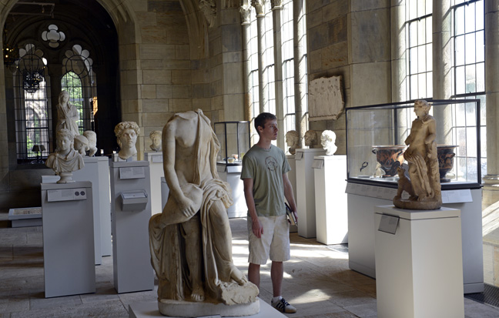
Attractions & Resources
Yale Attractions
New Haven Attractions
University Resources for Summer Students
Take a Yale Tour
Notes:
Attractions and Resources. Yale and the City of New Haven have many attractions for you to explore this summer! There are also numerous resources available to you!
Click on the links below to read about what those attractions and resources are. Many of the Yale attractions are free with your Yale ID. You can also take a free tour of the Yale campus through the Yale Visitor Center.

Slide 13
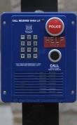
Safety on Campus
Blue Phones
Shuttle Bus
Nighttime Shuttle Rides and Walking Service
Download the “Live Safe” App (select Yale University)
Notes:
Safety on Campus. Yale is located in the heart of a vibrant urban community. With city living, it is important to take steps to stay safe. There are blue phones located all over campus.
You can press the red button to directly get in contact with Yale’s Police department if there is an emergency and you need help right away. By pressing the black button on the blue box, you can call any office at Yale using the last 5 digits of the phone number. To call Summer Session, you would dial, 2-2430.
Shuttle buses will provide you free transportation all around campus. They have a daytime route and a nighttime route. We advise against walking alone at night. Always walk with a friend.
If you do not have someone to walk with, you can contact Yale security for an escort and they will safely transport you on campus at night. They will either drive you or walk with you. You just need to know your NET ID to use this service. Click the link to learn more about it.
Lastly, you can download the ‘Live Safe’ App from the App store (select Yale University). It’s an app that tells you how to be safe on campus and provides additional resources.

Slide 14
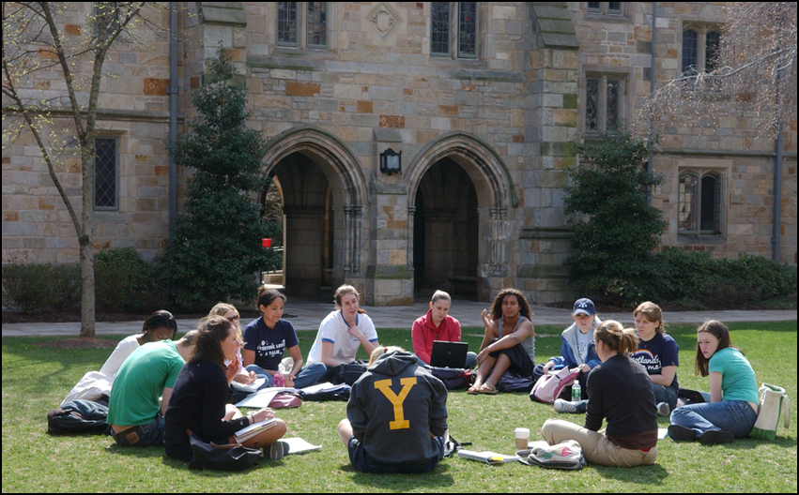
Contact Us
55 Whitney Avenue, 4th floor
(203) 432-2430
summer.yale.edu
summer.session@yale.edu
/ YaleSummer
@YaleSummer
Notes:
We look forward to your arrival at Yale this summer! If we haven't addressed all of your pre-arrival questions please email us at summer.session@yale.edu or call our office.

